Slide 1
Gitlab.com using ‘Gitkraken’ tool
Configuration Management Tool

Slide 2
Group members
Sai Kwon Kham 4SE-3
Kyaw Myo Htet 4SE-15
Aung Phyo Maw 4SE-21
Arkar Win 4SE-22

Slide 3
Outline
Git overview
Gitkraken (Git GUI tool)
Features of Gitkraken
Advantages of Gitkraken
Git configuration
Git running

Slide 4
Git overview
Version control system
Keep track of changes of files overtime

Slide 5
Git overview
Why is Git used?
Let say working on a.txt
Version 1 – a1.txt
Version 2 – a2.txt
Version 3 – a3.txt
This is called Version Control.

Slide 6
Git overview
But this is not manageable.
You have to copy the entire file when there is a version you have to save.
This is where a git comes in!

Slide 7
Git overview
We can use Git through either the command line or some kind of git interface (like SourceTree, TortoiseGit, Gitkraken, GitUp etc.)

Slide 8
Git overview
Once Git is used, it put ‘.git’ folder (git repository) within the project root.
It keep track of all the versions of the files overtime.
Can reverse to previous versions if something is wrong

Slide 9
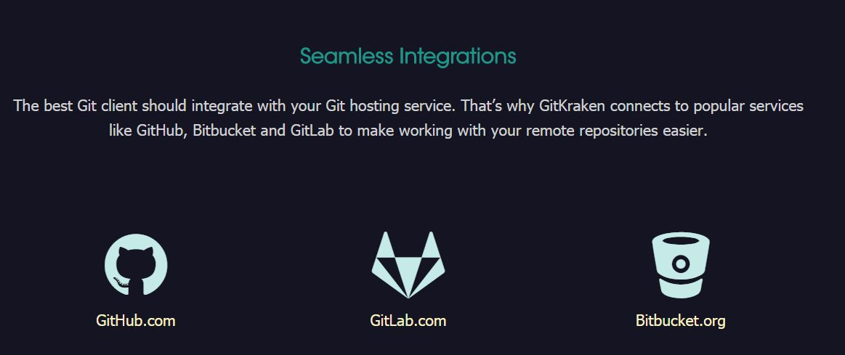
Most Popular Git Hosting Services
*

Slide 10

Git Interface

Slide 11
Gitkraken
Axosoft GitKraken is a cross-platform Git client with efficiency, elegance and reliability at the core. It was made for devs by devs.

Slide 12
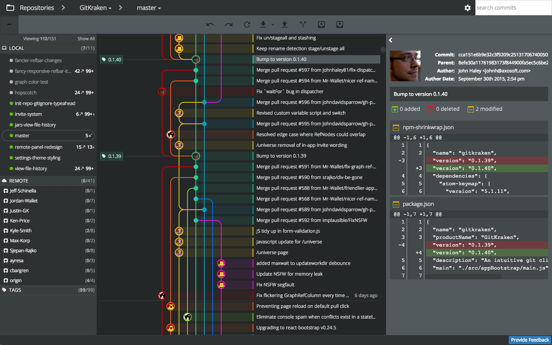
Gitkraken

Slide 13
Features of Gitkraken
can do all the standard things with a git client; branching, merging, pulling, pushing, reverting, etc.
some of the features that aren’t trivial to do in the CLI.

Slide 14
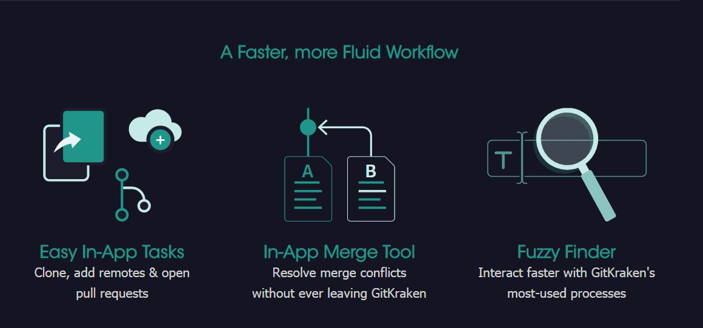
Gitkraken

Slide 15
Advantages of Gitkraken
Fast because changes are made locally other than on a remote server
Can change branches, view history, commit change offline
If another user made unwanted changes, other members still have a copy of full repo that can be restored.

Slide 16
Branches
Branches are made when working on a new feature or fixing bugs
Branches are then merged to incorporate the work into original master or other branches.

Slide 17
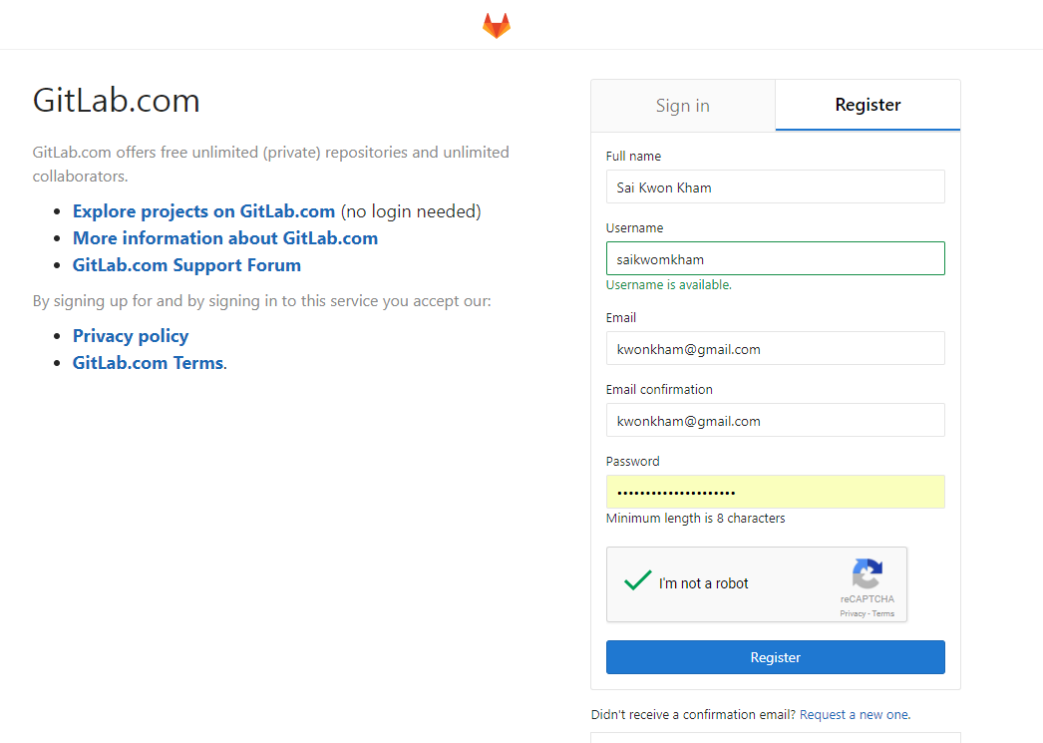
Git configuration
Register at gitlab.com

Slide 18
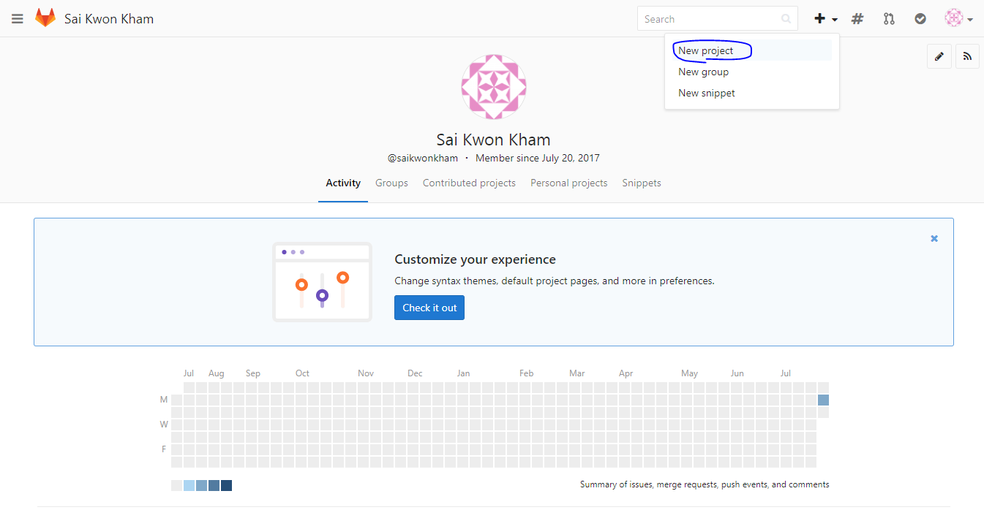
Git configuration (gitlab.com)
Create new project at gitlab.com

Slide 19
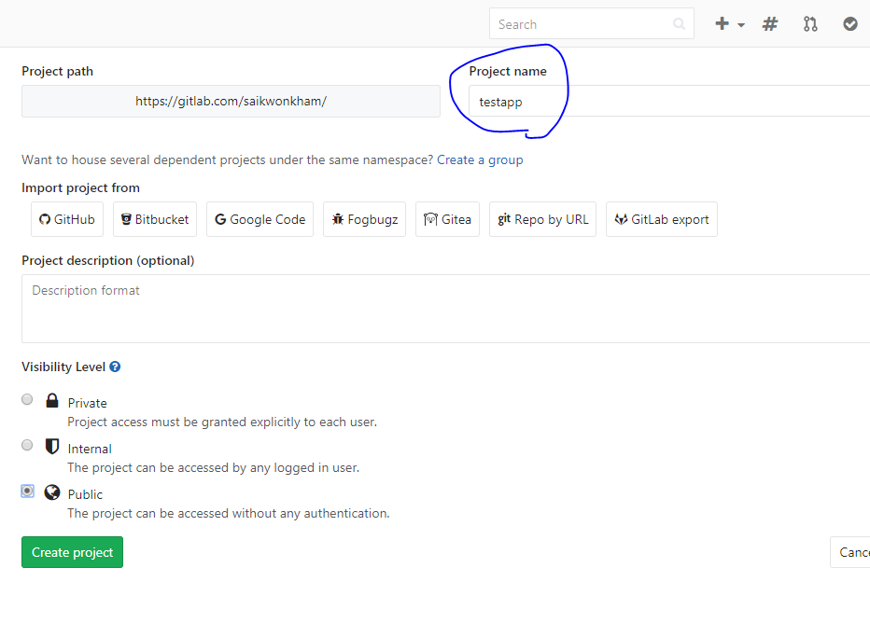
Git configuration (gitlab.com)
Create new project in gitlab.com

Slide 20

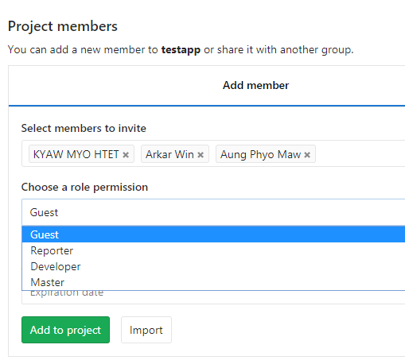
Git configuration (gitlab.com)
Add members

Slide 21

Git configuration (gitlab.com)
The project is ready to clone.

Slide 22
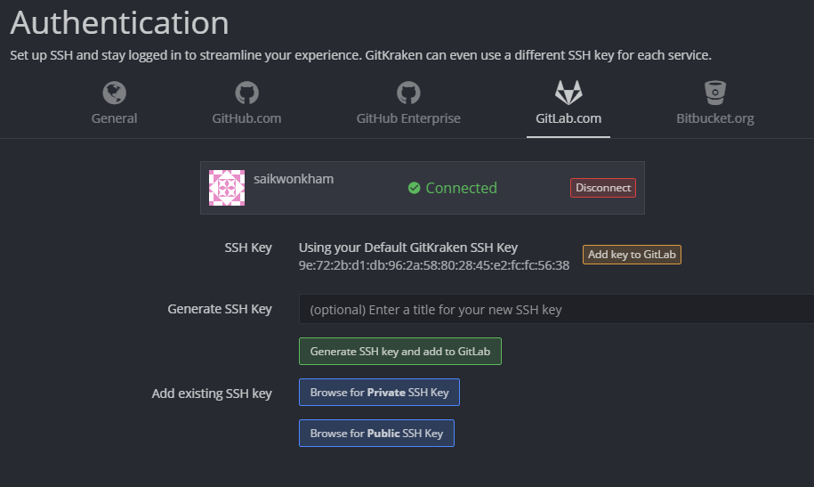
Git configuration (Gitkraken)
The project can also be created from Gitkraken tool

Slide 23
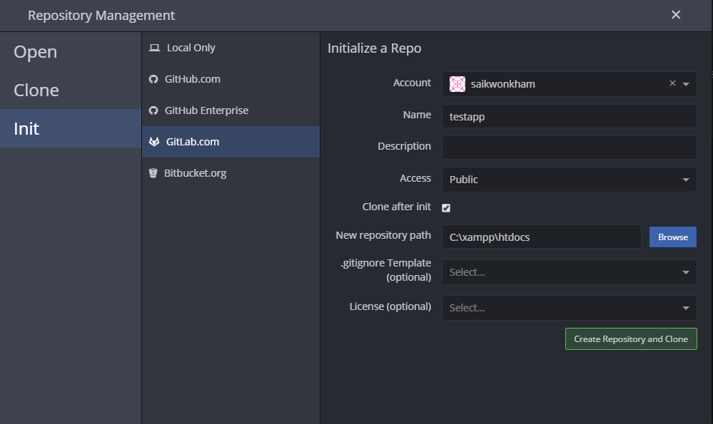
Git configuration (Gitkraken)
If init from Gitkraken, the project is already cloned to local machine

Slide 24
Git configuration (Gitkraken)
The project is created from Gitkraken tool

Slide 25
Git running
Git clone, open
Staging
Commit
Pulling, pushing
Branching
Create tag
Solve Merge conflict
Reverting
Diff
View history

Slide 26
Thank You

